Slide 1
Green Cloud Computing

Slide 2
What is GCC?
The term combines the words green -- meaning environmentally friendly -- and cloud, the traditional symbol for the internet and the shortened name for cloud computing.
Green cloud computing is a coined term that means making the practices and approaches of using technological advances like computing and other IT resources sustainable for potential environmental benefits.

Slide 3
Cloud Computing and Green Computing:
It constitute of two basic terms:
Cloud computing:
CC is internet service that provides computing needs to computer users.
Green computing:
GC is that a computer and technology is how much responsible for environmental change. It’s a study of sustainable computing and IT.

Slide 4
When it started:
The term Green computing came into existence with the launch of Energy Star program in 1992 by U.S environmental protection agency. It aims towards electricity saving and less amount of heat generated by the computers. Widespread use of computers and related IT products has a very bad effect on the environment.

Slide 5
WHY we use GCC?
Less usage of energy for producing, using, and disposing of products, which translates into lower carbon dioxide emissions.
Saving energy and resources saves money as a result of more efficient computing and running software.
We need GCC solutions that cannot only save energy but also reduce operational costs and enrich environment sustainability.

Slide 6
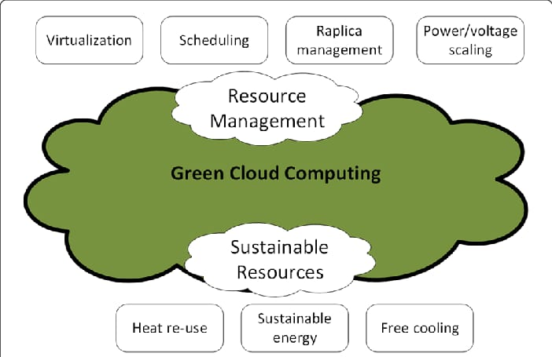
Infrastructure of GCC

Slide 7
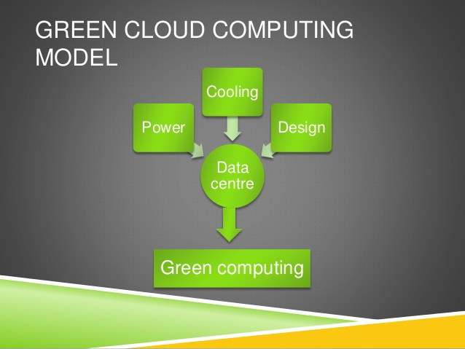
GCC Model
Uses energy efficient technology
Advanced technologies to store, manage and operate the data

Slide 8
Benefits of GCC
Conserving Energy by Green Cloud Computing
Remote Working reduces the Carbon Footprint in the Environment
Going Paperless with Green Computing and Cloud Computing
Reduction in E-waste Generation

Slide 9
Drawbacks of GCC
Some drawbacks of GCC are as under:
System support
Implementation Cost is High
Maintenance
Evolving Technology will be challenging to Adapt To.
IT Knowledge
In order for using the green IT infrastructure, IT experts who has well knowledge about the technology needs to be deployed. Those experts are rare to find, and if found they need to be paid plenty of money. If not appointed, your systems could eventually experience downtimes and other technical issues.

Slide 10
Examples of Green Computing .
Apple
who is building a new corporate center, is planning to use most of the building’s wind turbine technology
Google
Google has already built a wind-powered data center.
Amazon Web Service
AWS recently announced the Customer Carbon Footprint Tool for its cloud customers.
Microsoft Azure and Cloud for Green Cloud Computing
The company plans to boost this(Without RECs, Microsoft’s data centers run) to 70 percent renewable energy by 2023.

Slide 11
Researches on GCC
The Impact of Green Cloud-base Computing on Environmental Sustainability in Nigeria
Published in Asian journal of research in computer science.
Article published : March 2022
Author’s Names:
Rose O Akoh
Aliyu Ashiru
Agbata Celestine
https://www.researchgate.net/figure/Carbon-green-architecture_fig1_359239318

